Slide 1
REVIEW WEEK
SPRINT 4

Slide 2
WHAT WE DONE FROM WEEK 1 TO 5
Collected the requirements of the project
Understands the feasibility of the project
Created the work environment which helps to implement agile methodology
Creates the designs – UI for the application
Identified and implemented the risk and quality management plan
Implemented some user stories for our application

Slide 3
USER STORIES – ADMIN USERS
I can login into the system
I can add new student ID’s
I can delete and edit the existing student details
I can add equipment details (Name, ID, Location)
I can delete and edit the existing equipment details
I can view list of student details
I can view list of equipment details
I can add/Delete campus details
I can track the student history
I can see student details individually
I can logout of the system

Slide 4
USER STORIES – LAB MEMBERS
I can login into the system
I can view the list equipment in the laboratory
I can search the equipment as per my work
I can book the equipment
I can view the history of my own
I can see the due date of the equipment which I borrowed from the laboratory
I have an option to withdraw my equipment before the due date
I can logout of the system

Slide 5
PRIORITIZING USER STORIES
Create two different dashboards for admin and student in our application.
Create UI design for each page.
Create table for students and equipment where it could be useful for two users (students and Admin) for add, delete, edit, view.
Create the booking system for students, it is one of the important requirements from the client side.
Create search option to check with equipment’s availability
Create tracking system to view the history of students who have borrowed from laboratory
Create withdraw option for students to return equipment before the due date.
Create search option to view student details inclusive of history, recently borrowed from laboratory.

Slide 6
WORK CARRIED OUT BY EACH TEAM MEMBERS IN OUR GROUP
ADARSHA MANI – Code development
JAVAGAL SRINATH – Designing of user interface
BANDANA KAPALI – Documentation part
MARUF – R/D on application and supports on necessary tasks

Slide 7
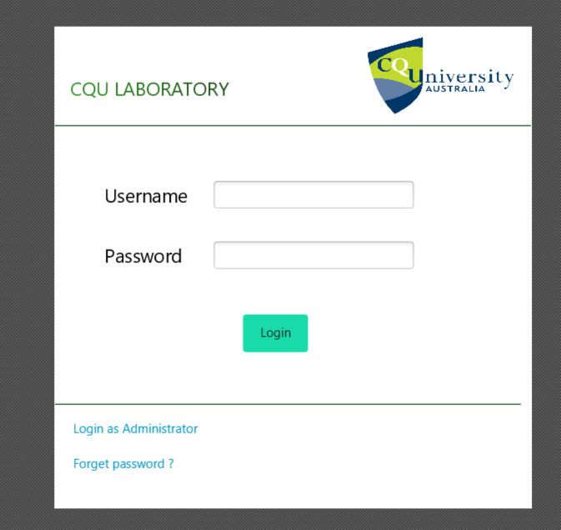
USER STORIES IMPLEMENTATIONS – FXML FILES

Slide 8
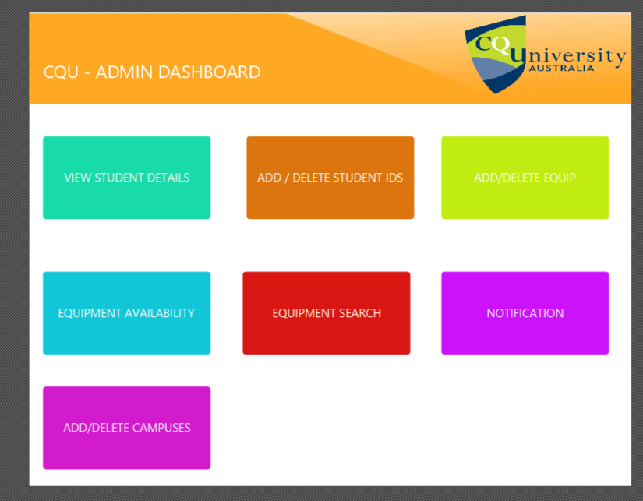
USER STORIES IMPLEMENTATIONS – FXML FILES

Slide 9
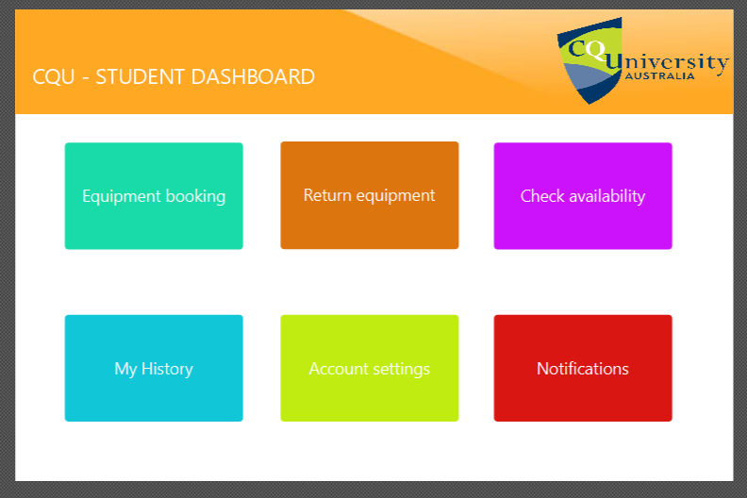
USER STORIES IMPLEMENTATIONS – FXML FILES

Slide 10
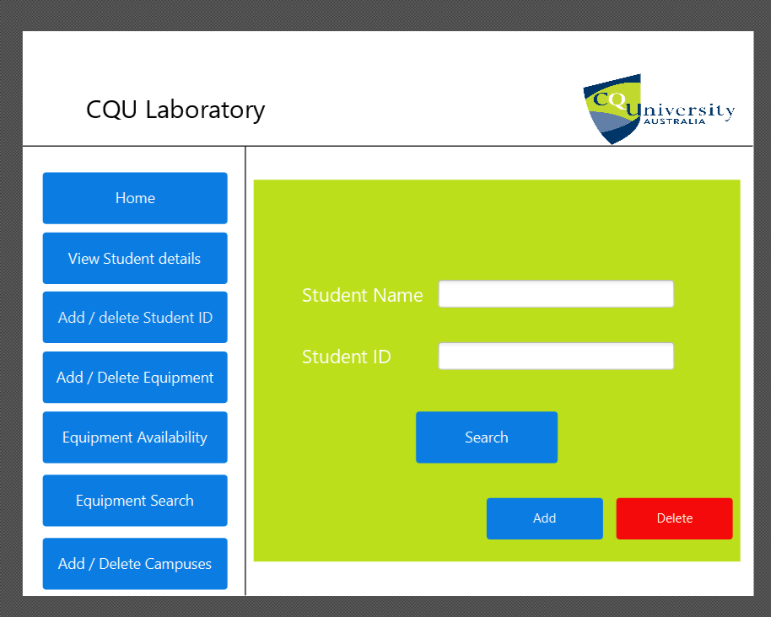
USER STORIES IMPLEMENTATIONS – FXML FILES

Slide 11
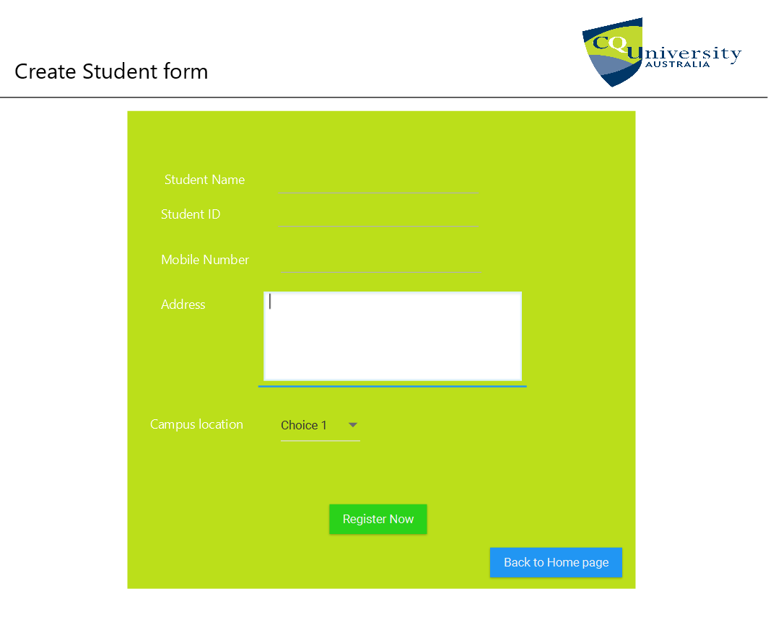
USER STORIES IMPLEMENTATIONS – FXML FILES

Slide 12
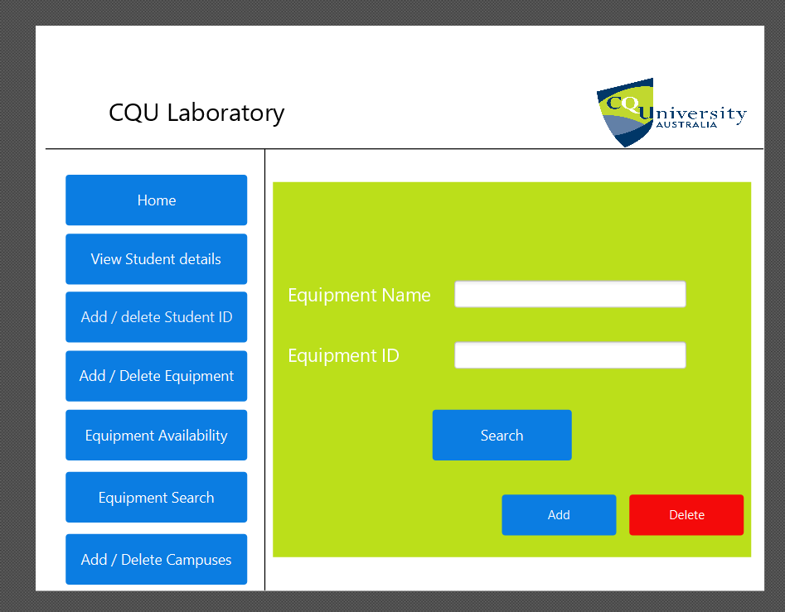
USER STORIES IMPLEMENTATIONS – FXML FILES

Slide 13
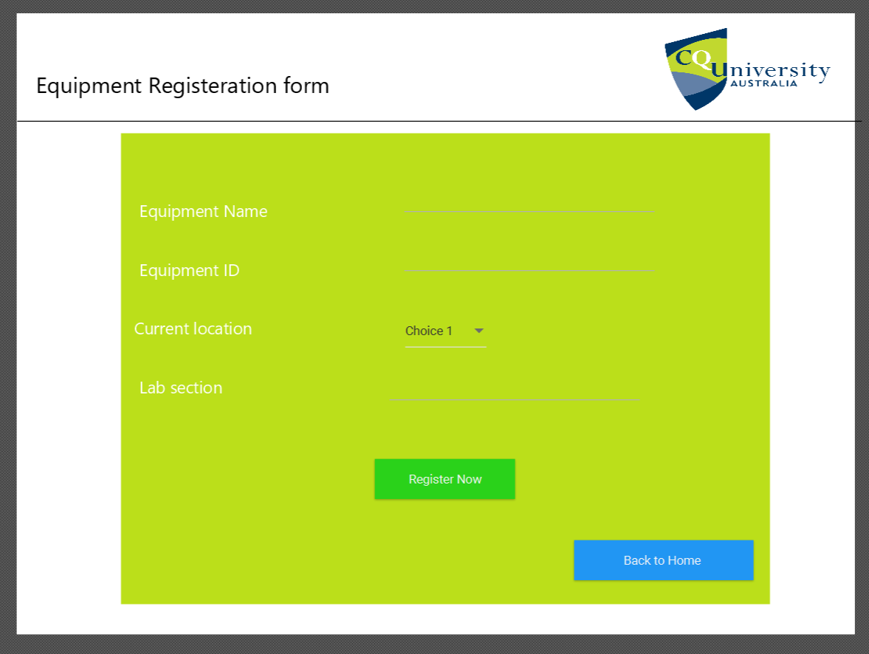
USER STORIES IMPLEMENTATIONS – FXML FILES

Slide 14
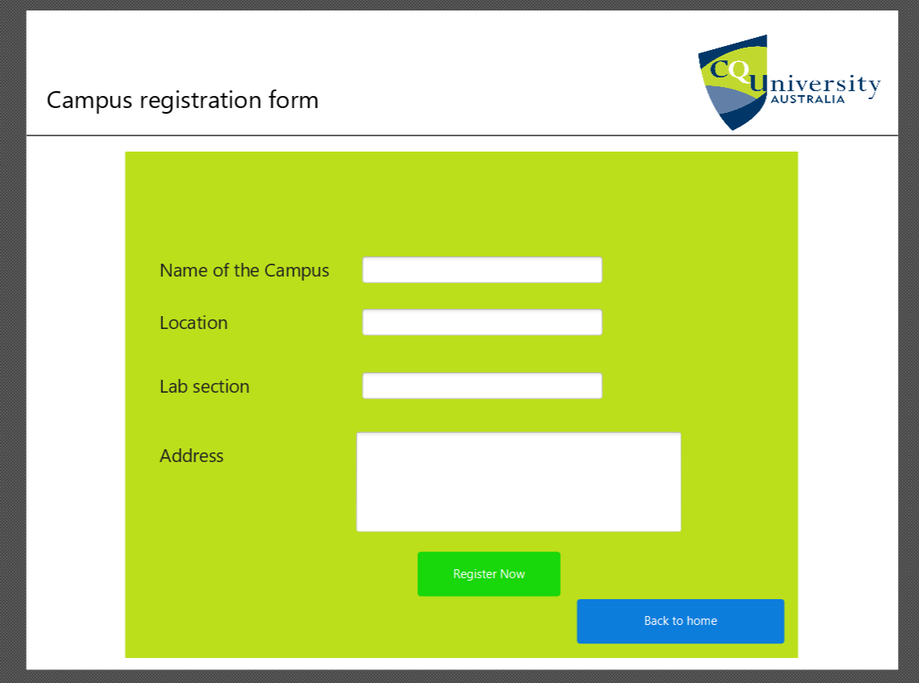
USER STORIES IMPLEMENTATIONS – FXML FILES

Slide 15
TEST CASES – LOGIN
Test No. | Test Name | Input | Expected Output | Actual Output | Remarks
 | Login Portal Check (For Admin Login) | Username: admin Password: admin1 Login Button Clicked | Admin Dashboard needs to be displayed. | Admin Dashboard was displayed. | PASSED
 | Login Portal Check (For Member Login) | Username: student Password: student1 Login Button Clicked | Member Dashboard needs to be displayed. | Member Dashboard was displayed. | PASSED

Slide 16
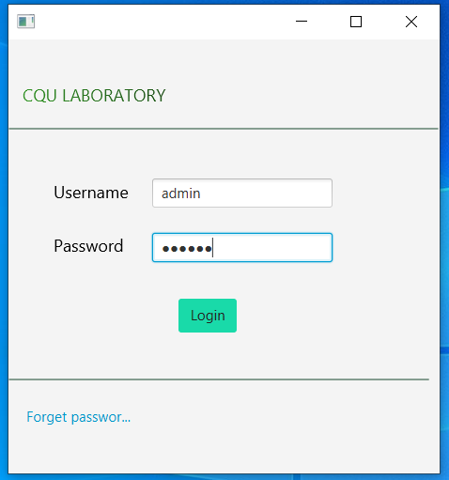
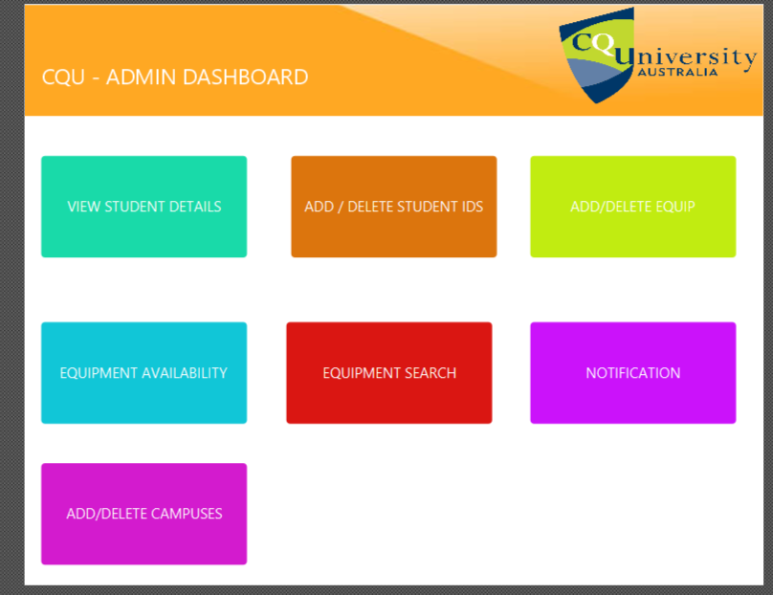
TEST CASES – EVIDENCE OF WORK
Figure 1 Admin Logging in from Login Page
Figure 2 Admin Dashboard displayed after Admin Logged In

Slide 17
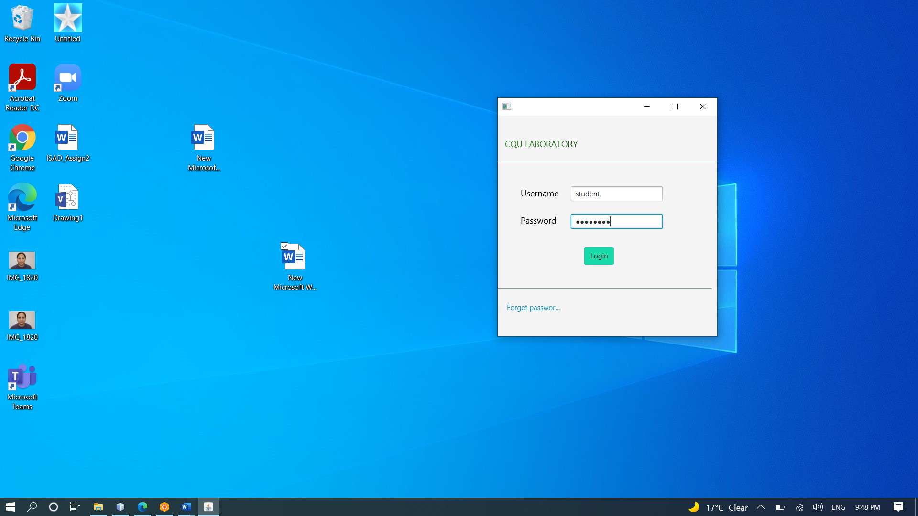
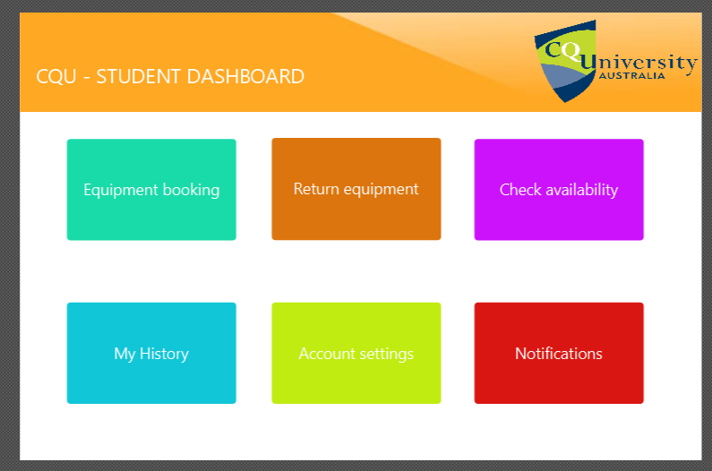
TEST CASES – EVIDENCE OF WORK
Figure 3 Member Logging in from Login Page
Figure 4 Member Dashboard displayed after Member Logged In

Slide 18
TEST CASES- ADMIN DASHBOARD
Test No. | Test Name | Input | Expected Output | Actual Output | Remarks
ADMIN DASHBOARD PAGE
1 | ADD ADMIN BUTTON | Clicked Add Admin Button | A new window to add a new admin will be displayed. | A new window to add a new admin was displayed. | PASSED
2 | ADD STUDENT BUTTON | Clicked Add Student Button | A new window to add a new Student will be displayed. | A new window to add a new Student was displayed. | PASSED
3 | ADD STUDENT BUTTON | Clicked Add Equipment Button | A new window to add a new equipment will be displayed. | A new window to add a new equipment was displayed. | PASSED
4 | ADD CAMPUSES BUTTON | Clicked Add Campuses Button | A new window to add a new campus will be displayed. | A new window to add a new Campus was displayed. | PASSED

Slide 19
TEST CASES- ADMIN DASHBOARD - CONTD
5 | STUDENT DETAILS BUTTON | Clicked Student Details Button | A new window to search the student will be displayed. | A new window to search the student was displayed. | PASSED
6 | EQUIPMENT DETAILS BUTTON | Clicked Equipment Details Button | A new window to search the equipment will be displayed. | A new window to search the equipment was displayed. | PASSED
7 | LOG OUT BUTTON | Clicked Log Out Button | Admin will return back to the login page. | Admin returns back to the login page. | PASSED
ADD ADMIN PAGE
8 | REGISTER NOW BUTTON | Clicked Register Now Button | “New Admin Added” prompt will be displayed. | “New Admin Added” prompt was displayed. | PASSED
9 | BACK TO HOME PAGE BUTTON | Clicked Back to Home Page Button | Admin will return back to the admin dashboard. | Admin returns back to the admin dashboard. | PASSED

Slide 20
TEST CASES- ADMIN DASHBOARD - CONTD
ADD STUDENT PAGE
REGISTER NOW BUTTON | Clicked Register Now Button | “New Student Added” prompt will be displayed. | “New Student Added” prompt was displayed. | PASSED
BACK TO HOME PAGE BUTTON | Clicked Back to Home Page Button | Admin will return back to the admin dashboard. | Admin returns back to the admin dashboard. | PASSED
ADD CAMPUSES PAGE
REGISTER NOW BUTTON | Clicked Register Now Button | “New Campus Added” prompt will be displayed. | “New Campus Added” prompt was displayed. | PASSED

Slide 21
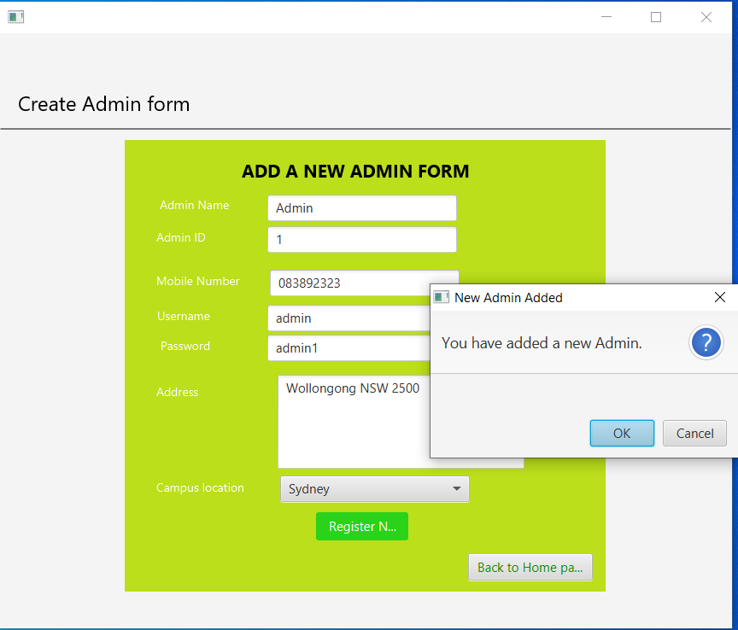
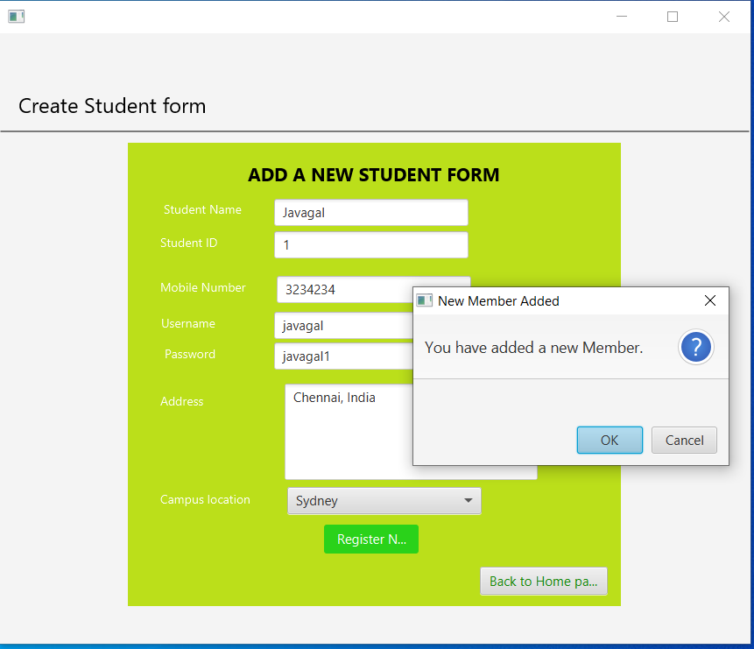
TEST CASES – SCREENSHOTS
Figure 5 Add a New Admin Form page
Figure 6 Add a new Student Form page

Slide 22
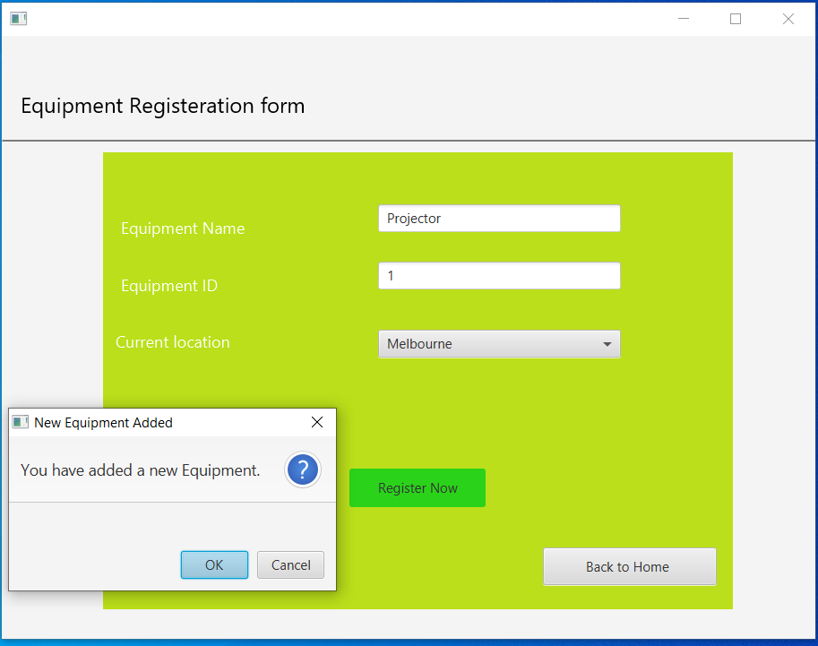
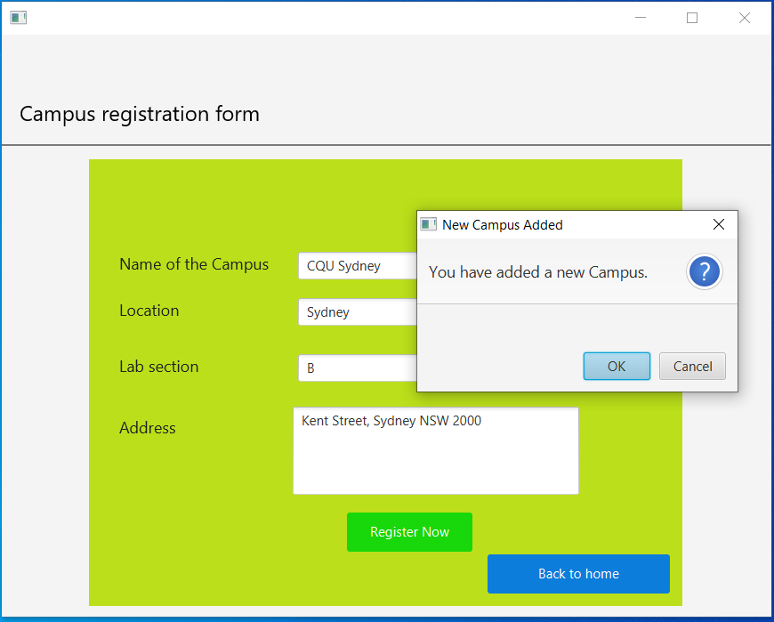
TEST CASES – SCREENSHOTS
Figure 7 Equipment Registration Form
Figure 8 Campus Registration Form Page

Slide 23
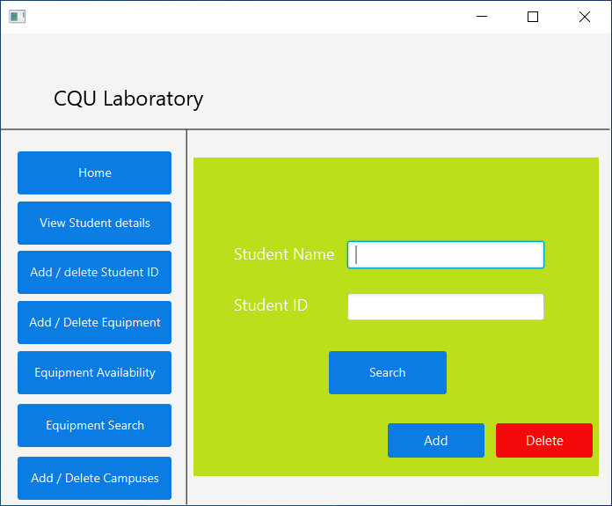
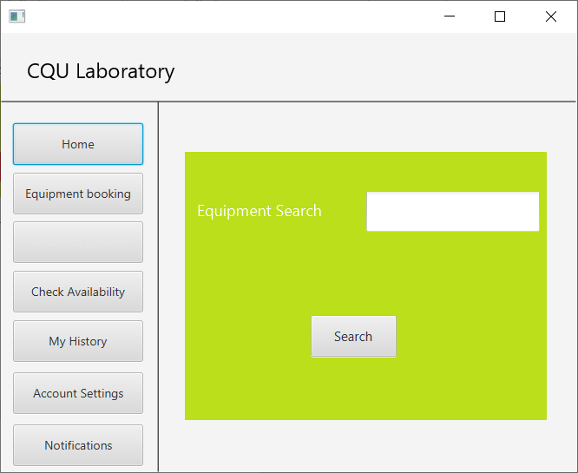
TEST CASES – SCREENSHOTS
Figure 9 Student Details Page
Figure 10 Equipment Search page

Slide 24
CURRENT PROJECT STATUS
Created UI prototype design for both admin and student users
Implemented the user stories for admin users
Updated and integrated the document from feasibility study to risk management.

Slide 25
WHAT WE PLANNED FOR UPCOMMING WEEKS
Implementing other user stories as well.
Focusing on developing fxml files for student dashboard.
Updating the document as per our implementation.

Slide 26
Thank You

